Slide 1
BazTech SOC Project
Building a Segmented Security Network with Wazuh

Slide 2
Introduction
BazTech Inc. is a startup focused on SOC simulations.
Goal: Improve visibility, detection & response.
Focus: Network Segmentation + SOC Monitoring.

Slide 3
Project Objectives
✅ Build segmented networks (LAN, DMZ, IT Dept, WAN)
✅ Deploy Wazuh for centralized log collection
✅ Simulate cyberattacks using Kali Linux
✅ Detect and correlate alerts across systems
✅ Provide actionable recommendations

Slide 4
Tools & Technologies
🛠️ pfSense (Firewall & Routing)
🛠️ Wazuh (SIEM)
🛠️ Ubuntu (Server in DMZ)
🛠️ Windows 10 (LAN Endpoint)
🛠️ Kali Linux (Attacker)

Slide 5
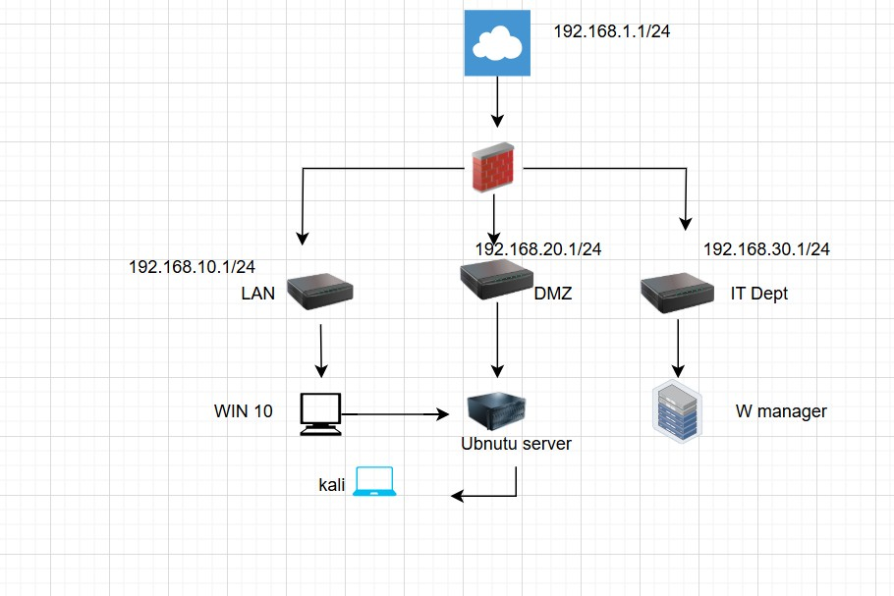
Network Design
Segmented across WAN, LAN, DMZ, IT Dept.
Wazuh Manager in IT Dept.
Endpoints in LAN & DMZ.
Kali Linux simulating attacks.

Slide 6
Attack Simulation
⚡ Kali Linux → SSH brute-force attack on Ubuntu server (DMZ)
⚡ Attempted lateral movement to Windows 10 (LAN)
⚡ Logs captured & centralized in Wazuh

Slide 7
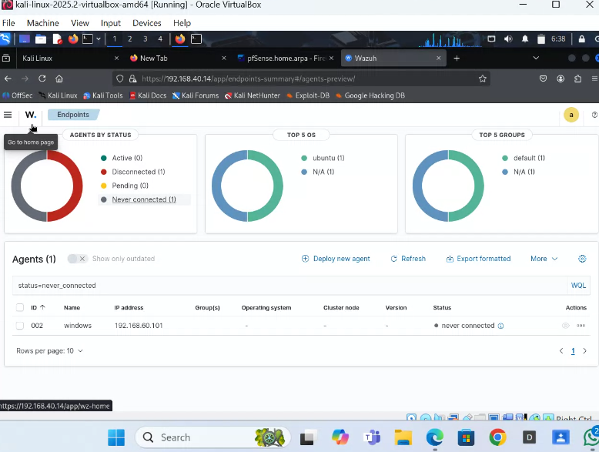
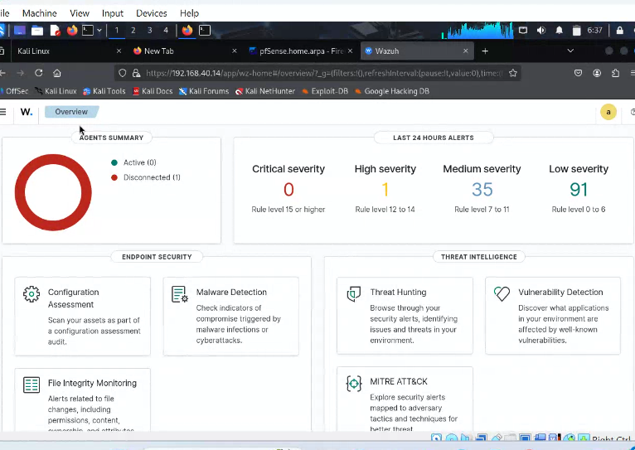
Detection & Monitoring
📡 Failed login attempts flagged
📡 Lateral movement risks identified
📡 Centralized alerts with severity levels
(See dashboard screenshots)

Slide 8
Findings
🚨 Unauthorized Access Attempts detected
🔁 Lateral Movement risks exposed
📊 Wazuh correlated logs across endpoints
⏱️ Suspicious login times flagged

Slide 9
Recommendations
🛡️ Enforce stricter firewall rules
🛡️ Enable SSH hardening (keys, rate limits)
🛡️ Improve segmentation policies
🛡️ Configure automated Wazuh alerts

Slide 10
Closing
💡 Key Takeaways
- SOC visibility improves security posture
- Network segmentation limits attack spread
- Wazuh provides real-time log correlation
- Hands-on SOC simulation = practical learning
👉 Always learning, always building stronger cybersecurity.
#CyberSecurity #SOC #BlueTeam #Wazuh #IncidentResponse #DefensiveSecurity

